Slide 1






Know Before You Go
March 2-6, 2025
Washington, D.C.

Slide 2

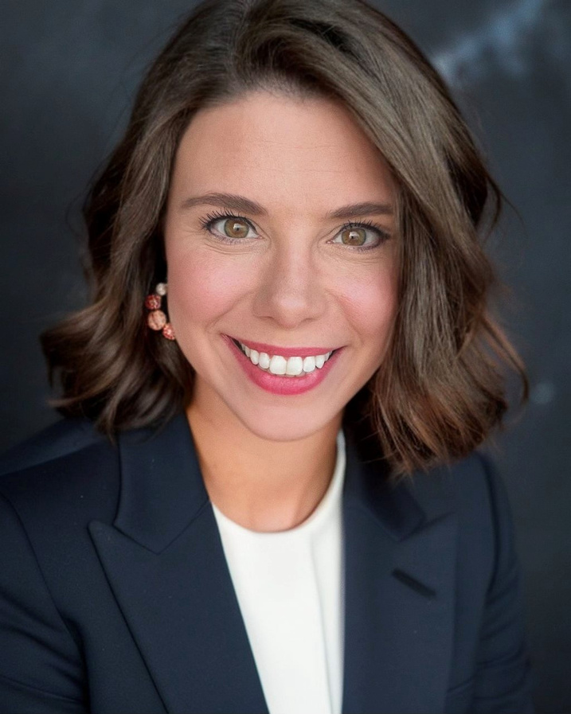

Welcome and League Update
From the President
Samantha A.M. Beeler
President
The League of Credit Unions

Slide 3
Welcome
Schedule
Prepare for the Hill
Legislative Priorities
Regulatory Priorities
Fundraising at GAC
Questions
Agenda

Slide 4
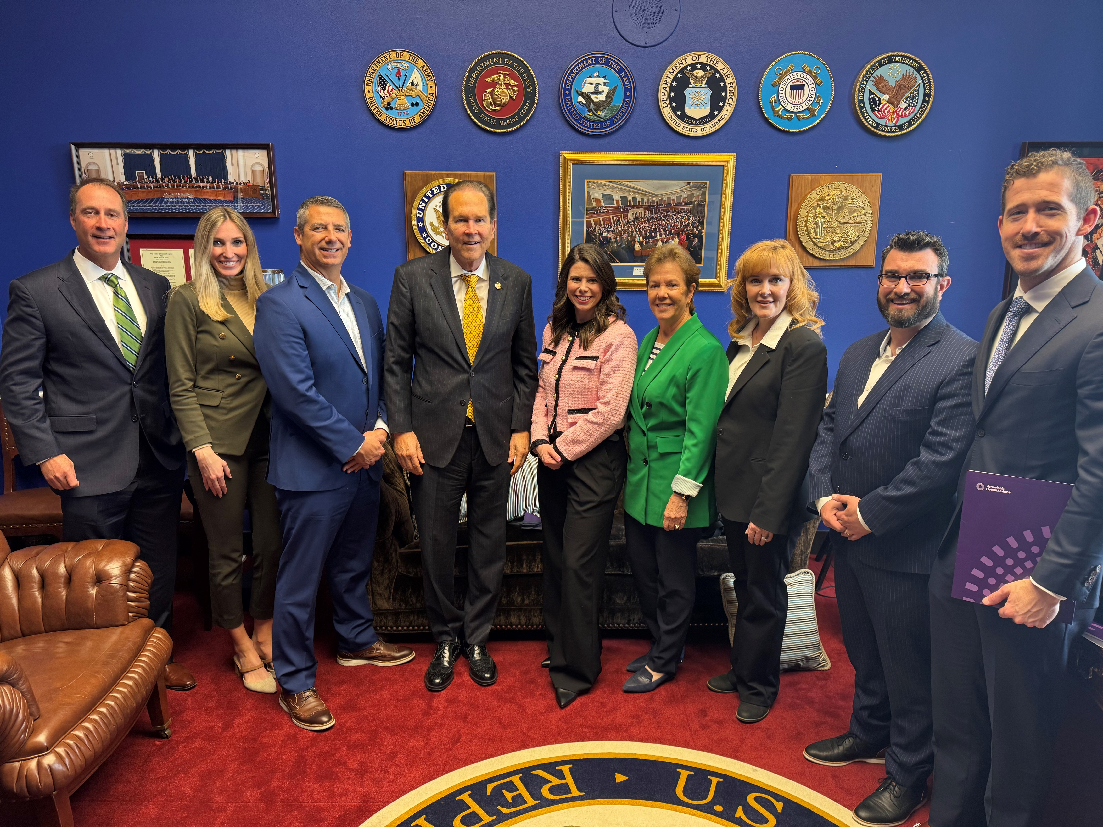
The Power of
Grassroots Advocacy
This opportunity to share the credit union difference and our structure as not-for-profit financial cooperatives to lawmakers is vital to the success of the entire industry.
These meetings also provide a window to engage and educate Congress on credit union priorities, such as interchange mandates, charter modernization, regulatory overreach, and more.
Credit unions advocating in-person helps moves the needle on legislative priorities.
Thank you for participating in 2025 GAC!

Slide 5
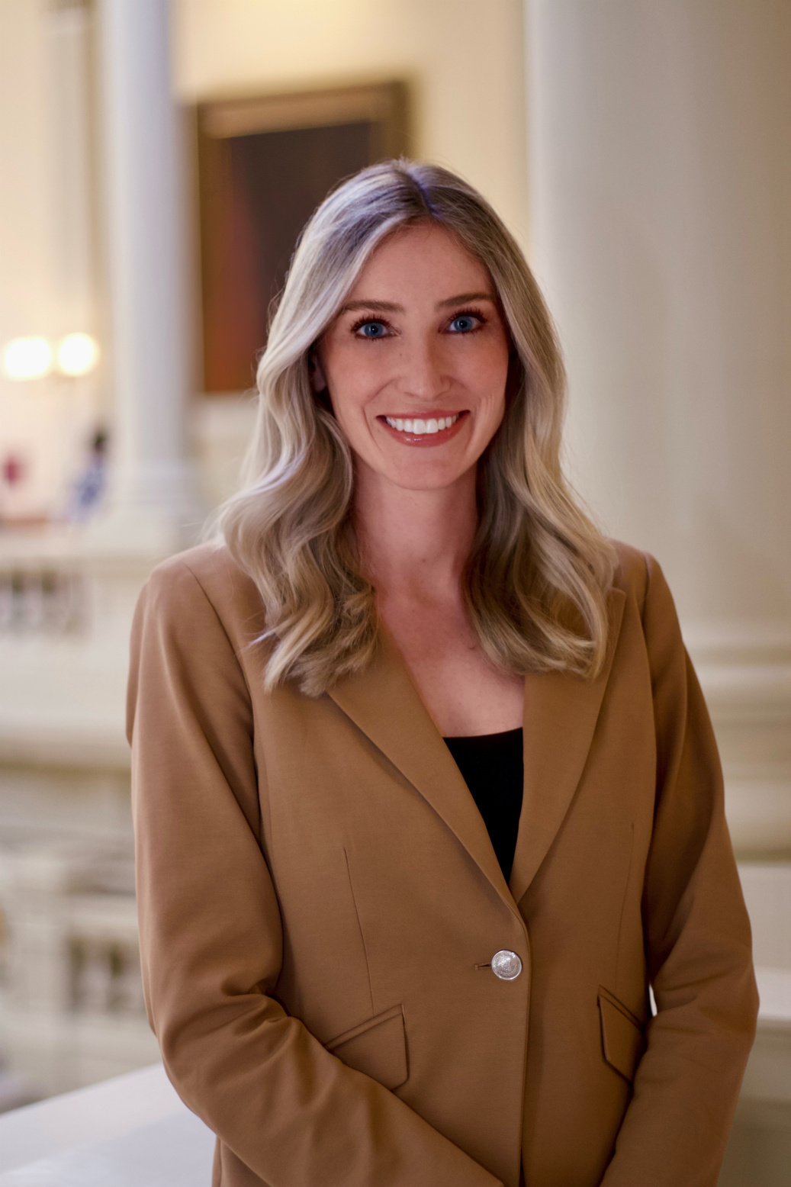
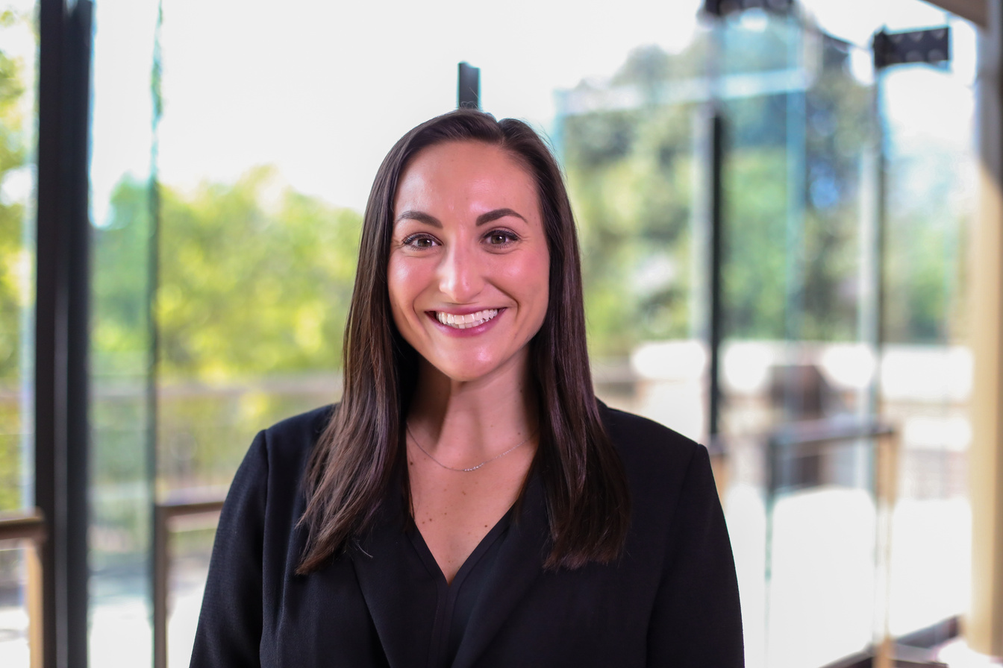
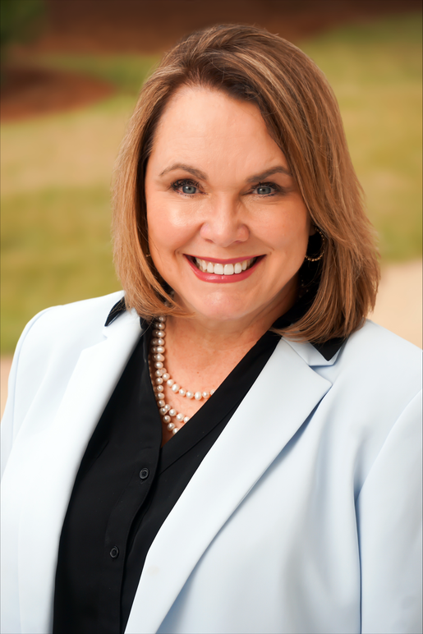

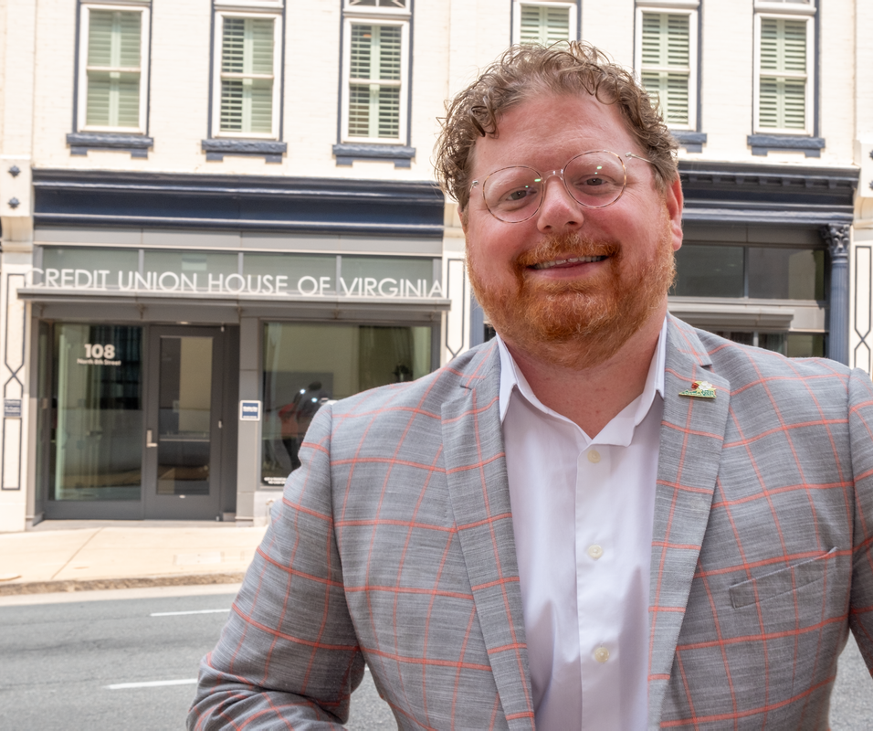
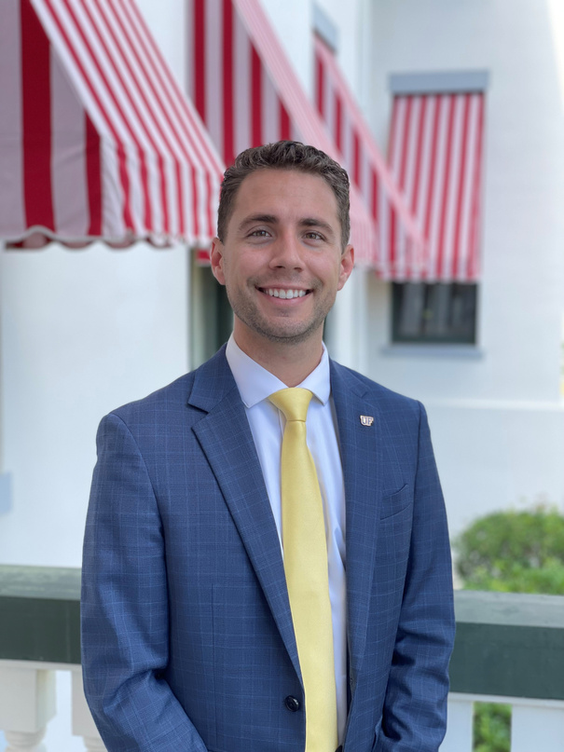
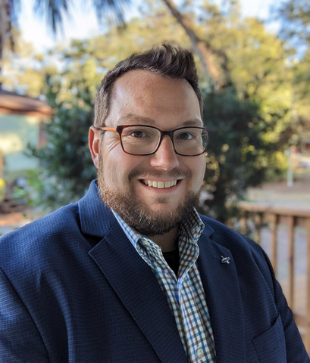


Your League
ADVOCACY TEAM
Grace Newcombe Colvin
Vice President of Federal
Advocacy and Strategy
Sydney Seral
Michelle Roth
JT Blau
CeJae Vtipilson
Grace.Colvin@the-league.coop
Vice President of Governmental
(256) 604-3770
Chief Advocacy Officer
Vice President of Advocacy
General Counsel
Sydney.Seral@the-league.coop
Michelle.Roth@the-league.coop
JT.Blau@the-league.coop
Affairs (VA)
(678) 542-3444
(334) 220-8741
(434) 237-9608
CeJae.Vtipilson@the-league.coop
(804) 731-9297
Christopher Hodge
Mat Willey
Josie Ellis
Ibby Dickson
Senior Director of Governmental
Manager of Regulatory Advocacy
Advocacy Specialist
Advocacy Specialist
Affairs (FL)
Mat.Willey@the-league.coop
Josie.Ellis@the-league.coop
Ibby.Dickson@the-league.coop
Christopher.Hodge@the-league.coop
(229) 977-0461
(251) 303-5286
(256) 226-9526
(850) 375-2532

Slide 6
Schedule of
Events
Sunday, March 2nd
  5:30 – 7:30 PM EST: 1934 Welcome Reception (hosted by The League, numerous other state Leagues, and VISA) at the MLK Jr Memorial Library
Monday, March 3rd
  4:00 – 5:30 PM EST: LEVERAGE and CULS Reception at the Marriott Marquis Bar
Tuesday, March 4th
  8:00 – 9:30 AM: Legislative and Regulatory Briefing in the Shaw Ballroom of the Courtyard Marriott
  10:00 – 10:50 AM: Meeting with CDFI Fund Director Pravina Raghavan in the Washington Convention Center
  11:00 – 12:00 PM: Meeting with NCUA Board Member Tanya Otsuka in the Shaw Ballroom of the Courtyard Marriott
  1:15 – 2:15 PM: Regulatory Panel with America's Credit Unions, Nacha, and John McKechnie in the Shaw Ballroom of the Courtyard Marriott
  4:00 – 5:00 PM: Meet and Mingle with NCUA Chairman Kyle Hauptman in the Shaw Ballroom of the Courtyard Marriott
  5:00 – 6:30 PM: Lawmaker of the Year Reception in the Shaw Ballroom of the Courtyard Marriott
Wednesday, March 5th
  8:00 – 5:00 PM: Hill Meetings
Thursday, March 6th
  Fly Home

Slide 7
Prepare for
Successful Meetings
We recommend dressing in business attire.
Give yourself enough time to get through security on the Hill. Lines can be anywhere from 15 to 30 minutes long.
Arrive at least 10 minutes early to the lawmaker’s office before a meeting. Wait in the hall until other credit unions arrive. These visits are extremely important to all attendees, and we want everyone to have the opportunity to participate.
The League will have already provided all materials to each office prior to the meeting.
Remember to bring a stack of your business cards to give out to Hill staff.
Be prepared – have talking points in hand!
Remember to take pictures that can be included in your credit union’s newsletter and in league publications. Our staff will take pictures as well.
Be sure to follow-up on your meetings with a “Thank You” letter, note, or email.
Actively participate in the meetings and keep discussion to credit union issues.

Slide 8
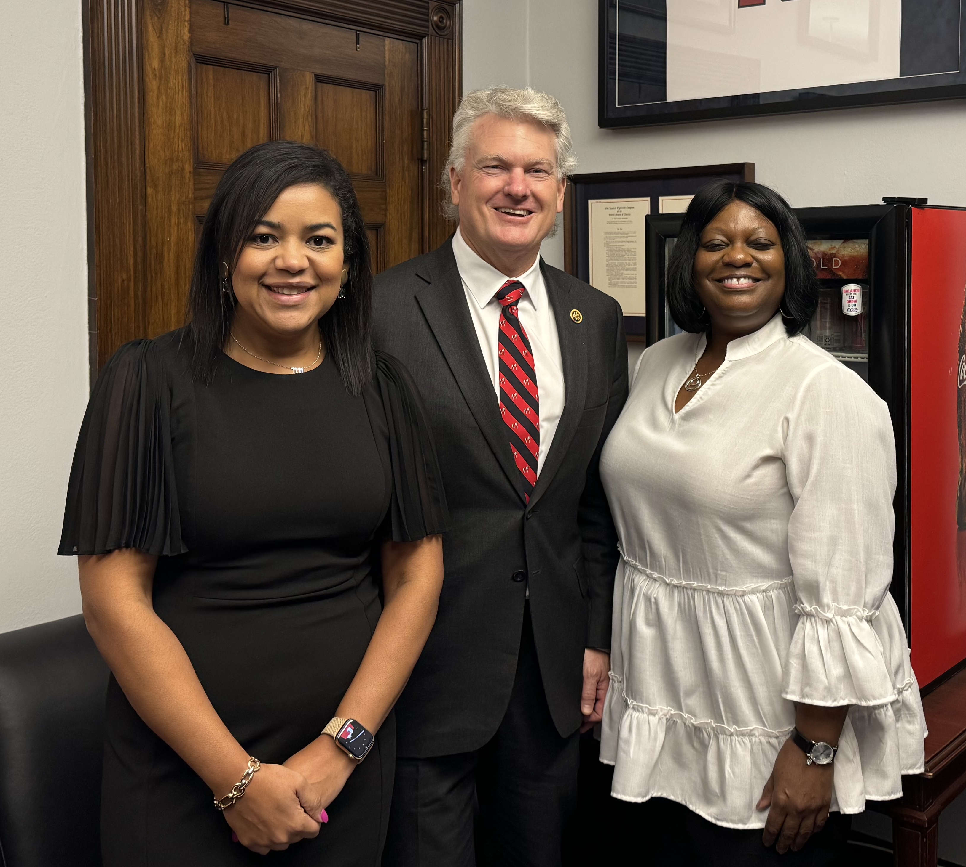
Credit Union
Team Leads
The League is looking for credit union team leads to help tee up legislative conversation and encourage attendee participation.
This will keep the conversation constituent-led, local, and focused on direct impact.
These meetings are an opportunity for you to share your credit unions’ stories, so they should be led from your point of view. We encourage all attendees to participate in Hill meetings.
If you are interested in being a team lead, we will be meeting after this zoom. Please email me the office(s) you would like to assist with.

Slide 9
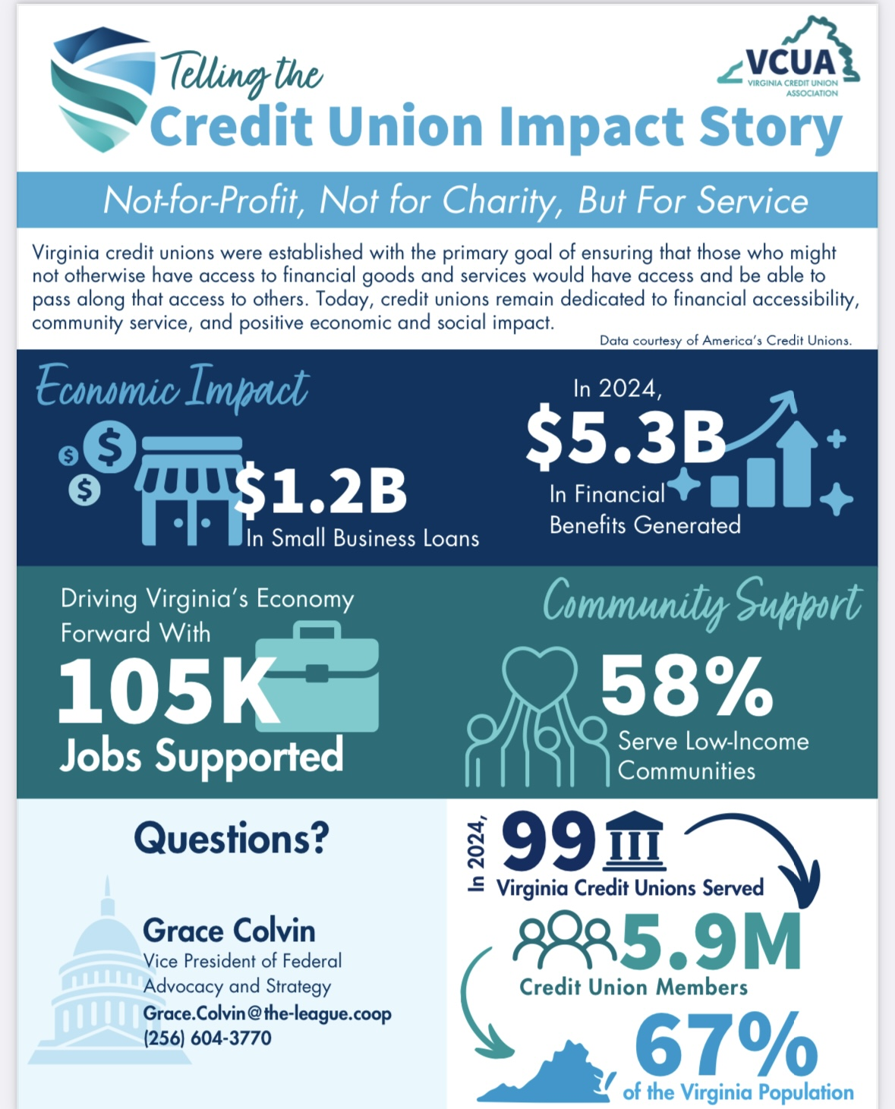
Leave Behind
One Pagers
The team lead will share The League one pager at the beginning of the meeting so staff and members can follow along.
For credit union specific one pagers, please coordinate with your team lead before you go into the office so everything can be handed over at once at end of meeting as wrapping up to avoid confusion.
Drafting a one-page “leave behind” sheet with important information on your credit union is not necessary but can be effective. Your “leave behind” should:
  List basic information about your credit union: size, membership, charter type, assets, basic product offerings, and branch locations.
  If you are a Minority Depository Institution (MDI), Community Development Financial Institution (CDFI), and/or a low-income designated credit union (LICU), please explain and elaborate on your programs.
  Detail benefits of our tax exemption, showing your credit union’s give-back and direct return of value to your members and the community. Please categorize this area as “financial wellbeing.”
  Offer to be a resource for constituent case work dealing with financial issues.
  Provide information on your credit union’s greater financial wellbeing efforts, such as lower-cost fees, expanded services to low-income or rural communities, details and numbers regarding financial services workshops, and examples of programs that directly and indirectly impact various communities within your membership.

Slide 10

Topics to
Avoid in the Office
Elections
Fundraising
Money
Controversial topics not related to financial services
Status of a loan
Calling a member by their first name

Slide 11
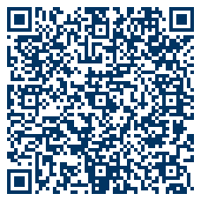
Be An Advocacy Insider
Get the most out of your conference experience with The League’s free events app and gain digital access to:
  Conference Agenda
  Legislative and Regulatory Meetings
  Member Profiles
  Attendee Lists
  Legislative Issues
  Maps
  Nearby Restaurants
  Photo Sharing
Download The League Events App
Checkout the website: https://lscu.coop/2025GAC/

Slide 12
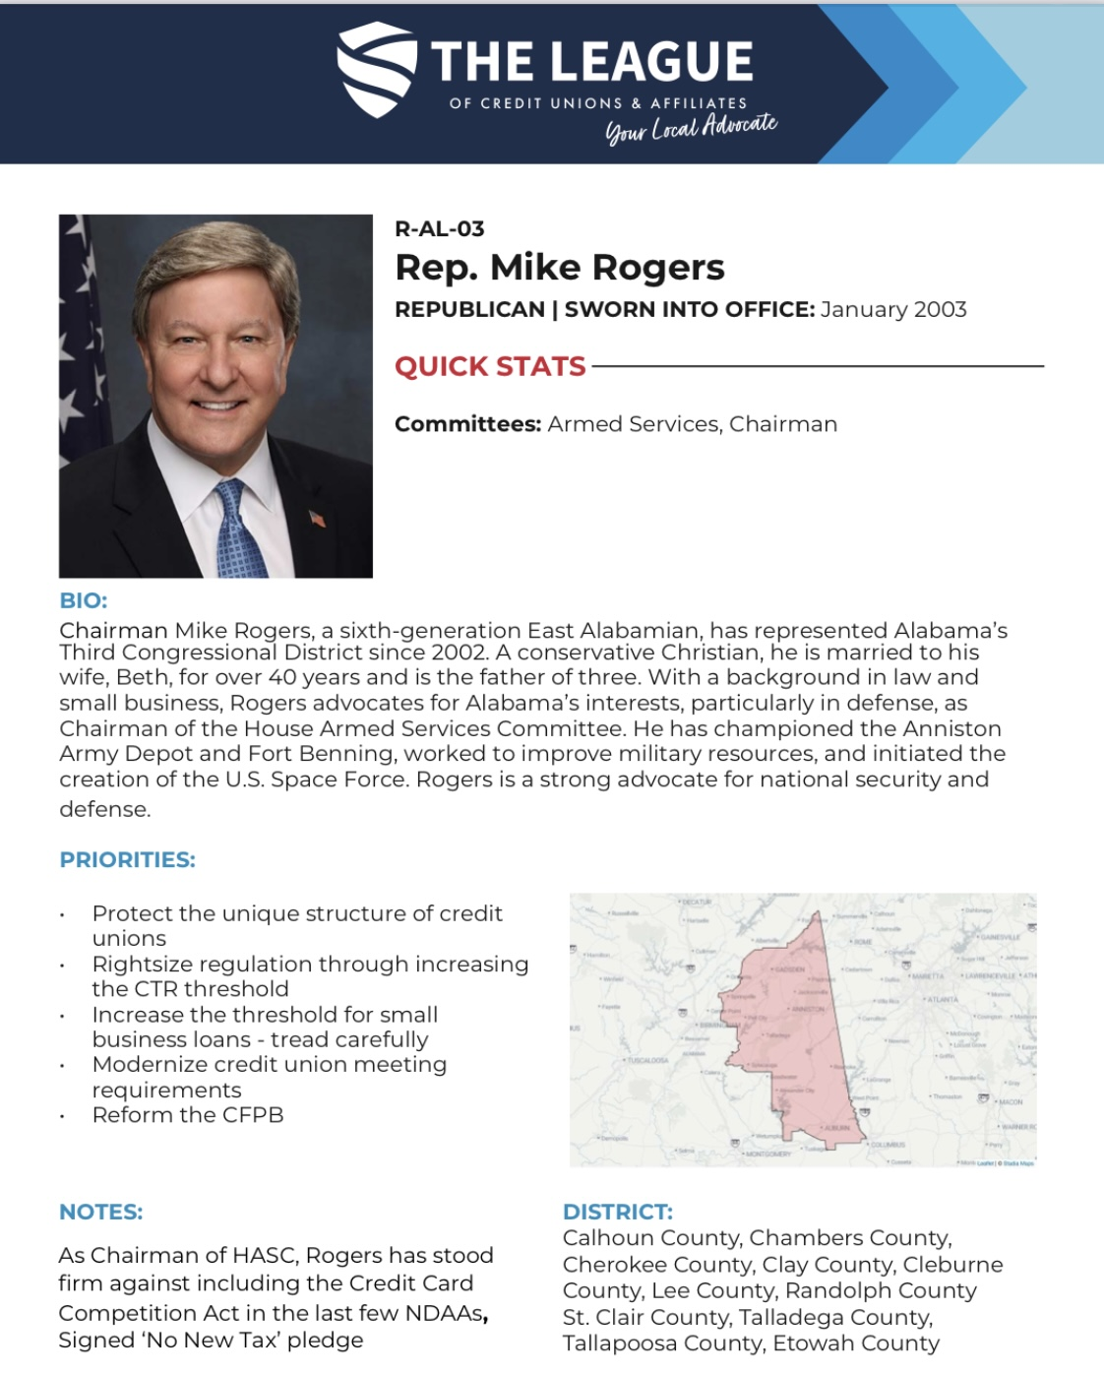
'The League Events' App
Resources for You
Meeting Details
Congressional Maps
Customized Options
  Member Profiles
  Things to Do Nearby
  Nearby Places to Eat
And More!

Slide 13
Legislative
Priorities
IMPACT
RELIEF
Credit unions boost local economies, contribute to job creation and growth, keep access to financial services affordable, and empower consumers.
Credit unions make significant contributions to state and federal tax revenue.
  Alabama: $372.9M
  Florida: $1.6B
  Georgia: $387M
  Virginia: $3.4B
Preserve the unique structure of not-for-profit credit unions.
Right-size regulation and support relief measures:
  Increase the reporting threshold for Currency Transaction Reports
  Expand access to credit for small businesses
  Modernize credit union meeting requirements
  Reform the CFPB

Slide 14
Legislative
Priorities
CTR Threshold
Has never been adjusted since implementation in 1972. If indexed for inflation, the $10,000 threshold would be close to $73,000.
In 2023, FinCEN reported receiving an average of 57,000 a day (nearly 21 million annually).
Credit unions support increasing the reporting threshold to $60,000 and including an automatic five-year adjustment for inflation.
Access to Credit
Credit unions are subject to an arbitrary 12.25% cap on member business lending. An exemption to this cap is small business loans under $50,000.
If adjusted for inflation, this threshold should be closer to $94,000.
Modernize Meeting Requirements
The Credit Union Board Modernization Act would decrease the number of board meetings a federal credit union must hold annually from 12 to no less than six.
This legislation includes an exemption for new credit unions and those with low soundness ratings (CAMEL score).
This legislation has now passed the House three times.
Reform the CFPB
Credit unions support increasing this exemption to $100,000.
The CFPB is in need of reform to truly protect consumers and combat predatory practices like payday lending and fraud. Further, past rhetoric from the CFPB has harmed public perception of the highly regulated financial services industry.
The Taking Account of Bureacrats Spending Act (TABS Act) would bring the CFPB under the traditional appropriations process.
In addition, we support increasing the threshold for CFPB supervision from $10B to $15B, reflective of inflationary pressure.

Slide 15
Issues
Additional
Independent Regulator
Banks Selling to Credit Unions
Debanking
Credit unions consistently look for ways to reach unbanked, underserved, and rural communities often left behind or overlooked by big banks.
Even as some community banks choose to sell to credit unions (which is usually the best decision for the community), our market share has not grown in over two decades, with banks controlling more than 90% of deposits.
There is concern that consumer bank accounts are getting closed (or denied account opening) over personal opinions on social issues.
Credit unions make risk-based decisions.
As big banks leave rural communities, credit unions, who are not the problem, are working to keep access local and affordable.
Credit unions, as not-for-profit financial cooperatives, need an independent regulator like the NCUA to ensure regulation supports our unique structure and mission.
We support right-sizing regulation and oppose unjustified oversight by outside agencies that do not understand our structure.

Slide 16
Regulatory
Priorities
NCUA
Supervisory Priorities
Credit Risk
Balance Sheet Management
Cybersecurity
Consumer Protection
Exam Updates
Expand Natural Disaster Assistance
Remove the requirement for a credit union to have a low-income designation when applying for disaster relief financial assistance via the CDRLF
Streamline CDFI Certification Process
Assist credit unions in setting up a joint work group with CDFI to provide recommendations that will modernize the process
Expand Board Reimbursement
Amend section 701.33 to allow Federal Credit Union (FCU) board members to be reimbursed for the cost of childcare when it is necessary to attend an official board meeting.

Slide 17

Regulatory
Priorities
Preserve CDFI funding in appropriations process
Simplify the CDFI certification application
Set up a joint work group with the NCUA to provide recommendations that will modernize the application and streamline processes
Community Development Financial Institutions Fund

Slide 18
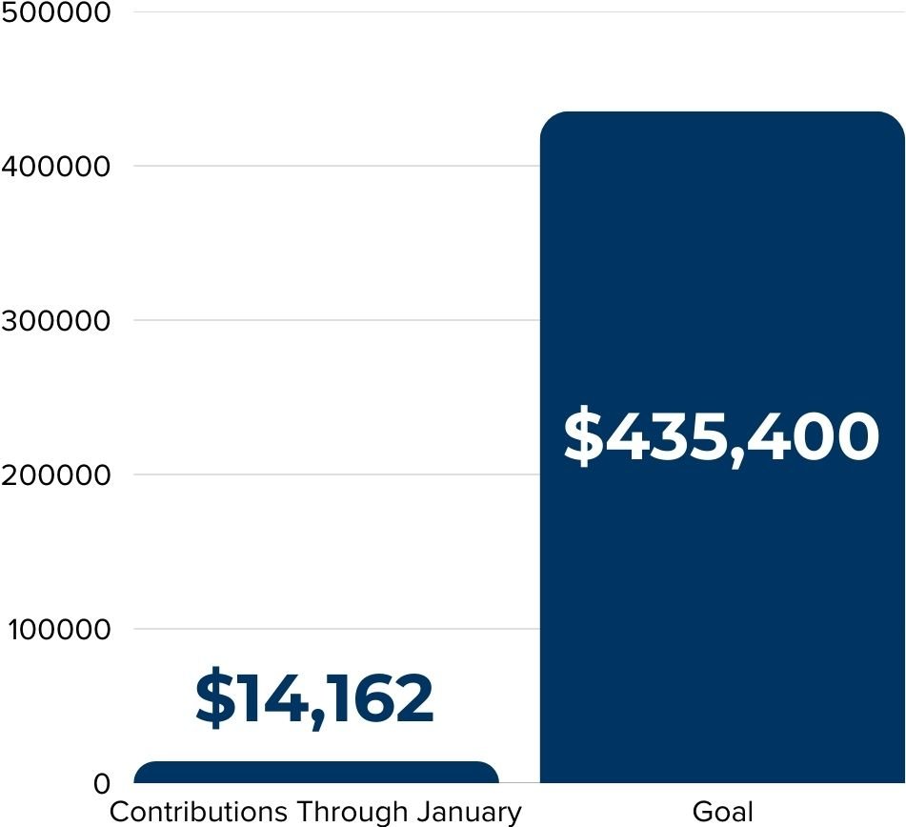
The League
Fundraising Update
This year, our CULAC sweepstakes giveaway item will be a $200 Amazon Gift Card!
Be sure to come visit us at the GAC receptions and make a donation to enter.
PAC support is incredibly important– make a donation to help us continue to support candidates for office who understand and support the Credit Union Difference!

Slide 19
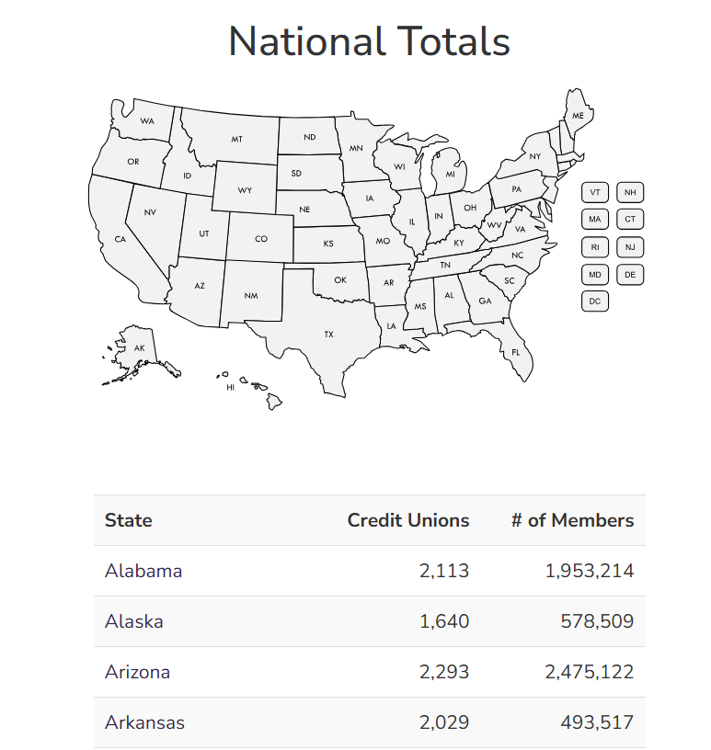
Request to Update
Project Zip Code
  Project Zip Code (PZC) helps legislators understand how many members reside in their district. Counts your members and matches them by congressional district, state legislative district and county.
  Having up-to-date information before GAC is crucial and helps illustrate the power of our movement.
  Visit www.pzconline.com

Slide 20


Questions?

